Slide 1

Foresight of the Most Appropriate Technologies 2025 Iran PAMFA Project

Slide 2
Outline
Methodology Framework
Introduction of Preliminary Phase
Introduction of Foresight Phase
Panel
Scenario Planning
Delphi questionnaire

Slide 3
Concepts of Foresight

Slide 4
Facing The Future: Exploratory Paradigm-Forecasting
Backward
Planning
Present
Future‌

Slide 5
Facing The Future: Normative Paradigm -Foresight
Preferable
Futures
Possible
Futures
Backward
Plausible
Futures
Vision
Probable
Futures
Present

Slide 6
Facing The Future: Normative Paradigm -Foresight
Preferable
Futures
Plausible
Futures
Scenario 1
Vision
Scenario 2
Scenario 3
Probable
Futures

Slide 7
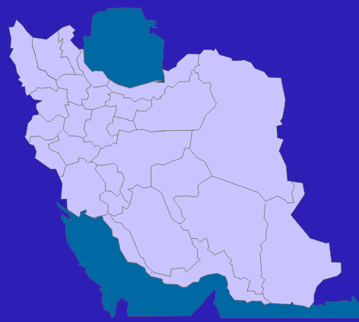
Regional & Global
Futures
National macro
futures
Sector Futures

Slide 8
Driving Forces
Driving forces are a compatible set or a cluster of one or several components that may shape the future
Major Considerations.
Not only one trend or driving force determines the future
Every driving force has different effects in each country and region
Driving forces are not always reinforce each other but they may have converse and neutral effects (driving forces with uncertainties)

Slide 9
Uncertainty
Such driving forces that are not certain and are unpredictable
Their existence depend on the behavior of a set of players
Examples:
Regionalism
Global Interactions
Integrated
Globalization
Decentralization
Internal Interactions
Centralization
9

Slide 10
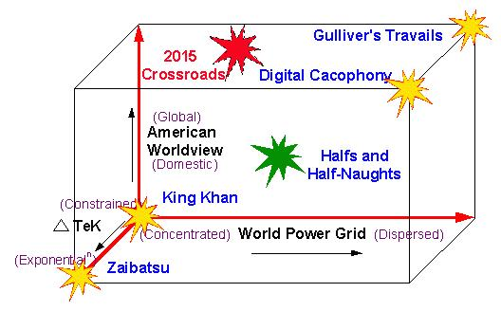
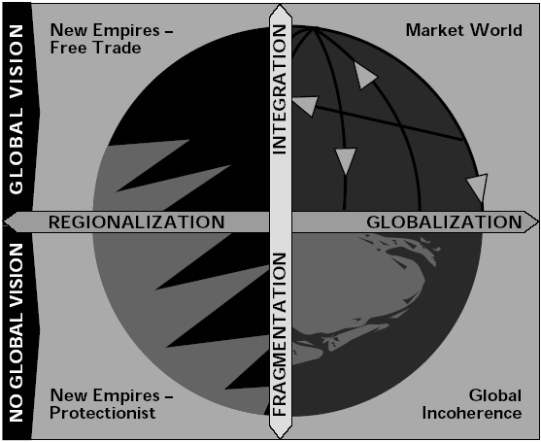
Inductive Method or Matrix 2*2 or 3*3
Select two driving forces that have deep uncertainty and are the most important
Examples:
Notes:
10

Slide 11
Relation between plausible futures and policy making
Robust strategy (priority)
Strategy
Scenario
Scenario logic

Slide 12
phases OF PaMFA project
preliminary
Pre Foresight
Expert Recognition: Co-nomination
Panel Setting
Main Foresight
Delphi / Scenario Planning
Post Foresight
UNIDO Seminar
8th Japanese Delphi
Workshop
Publication: Book / Paper
Workshop & Seminars
Result Presentation: Key Entities & Policy Makers
Design main foresight

Slide 13
Preliminary Phase

Slide 14
1- Tentative workshop (2004)
Establish a research team to study on foresight (2003)
Identification of key actors in STI environment
Invitation to participate as sponsor & supporter
Workshop for abstract introduction of foresight & announce the Program initiation (2004)

Slide 15
2- Seminar on Technology Foresight Practices and Methods Tehran, Iran, (3-7 December 2005)
Dr. Michael Keenan: UK
Policy Research in Engineering, Science and Technology (PREST)
Dr. Attila Havas: Hungary
Hungarian Academy of Science
Dr. Taeyoung Shin: South Korea
Science and Technology Policy Institute (STEPI)
Dr. Hariolf Grupp: Germany
Fraunhofer ISI
Dr. A. Metin GER: Turkey
KARAR Consultants Ltd.- Tubitak
Dr. Terutaka Kuwahara: Japan
National Institute of Science and Technology Policy (NISTEP)

Slide 16
3- 8th Japanese Delphi (2006)
The first idea was triggered in futures studies group in the center of National Research Institute for Science Policy (NRISP) in April 2006
The final design of institutional framework for performing the project accomplished in June 2006
Steering committee and secretariat of the project start their activity in November 2006
Before distribution of questionnaires two meetings were held for introducing the project
Members of steering committee of Iran pilot project 2025
NRISP
Ministry of Science, Research and Technology
High-tech industry center -Ministry of Industry and Mines
Electric Power Technology Development Center (MATN)
Aerospace research institute
Futures studies center of defense science and technologies
Research and Training Institute for Management and Development Planning

Slide 17
Why Japanese Delphi questionnaire?
Using Japan Delphi (8th round- 2006)
A good measure for benchmarking
High Validity
Same experience from other countries like Germany , France
Cooperation of numerous experts

Slide 18
Distribution of questionnaire
First round in February 2004 with participation of 60 experts (Iran Information system institute)
Posting questionnaires for 450 researchers
June 2005: 6 fields were selected for first round foresight:
Information & Communication
Nanotechnology
Electronics
Frontier Areas
Energy and Resource
Manufacturing
Totally: 6 fields, 63 domains and 399 topics

Slide 19
Results of plan
Two category of results:
Tangible results: formal and codified, identifiable, but with low Degree of importance
Intangible results: Informal and not codified, hard to be assessed, with high Degree of importance (noteworthy in pilot plans)
Other results that are considered in pilot plans:
Identification of context for the main plan (Including experts participating culture, organizers behavior, Existing capabilities)
Better estimation of main plan (resources including: time, money and knowledge)
Improving social culture for accepting and supporting the main plan
Experience for facilitators
Contribution for designing the main plan

Slide 20
PreForesight

Slide 21
Results of preliminary phase
Comments for the Main Foresight | Results of preliminary phase
Top-Down Support and issue some certificates for the participants It is necessary to spend more time for description of the method for experts and panel members | In other countries there were high participation rate without no payment motivation and just for access to the results. The most important reasons for low participation rate in plan were: novelty of program Uncertainty about the efficiency of results problems regarding the implementation of methodology Specialized Questions Widespread use of survey methods in Iran | Low Participation rate
Using panels for designing local questions, Identification of experts and writing scenarios | Iran questions and problems are totally different from Japan’s | Designing of questions

Slide 22
Results of preliminary phase (Ctd.)
Comments for the Main Foresight | Results of preliminary phase
Using scenario-planning methods with emphasis on uncertainties | Experts were unfamiliar with the complexities of questionnaire Analyzing of results is difficult for the audience Questions focus on local context | Foresight Methodology
Not using of quantitative approaches and rely on experts (Qualitative approach instead of Quantitative approach) | Lack of statistical Data | Data bank
Using the participative introduction method Using the existing networks in several sectors | Two main problems: Lack of enough experts Their participation | availability of experts

Slide 23
Results of preliminary phase (Ctd.)
Comments for the Main Foresight | Results of preliminary phase
Just ask experts about native factors | Experts should not be asked about the time of realization or about pioneer countries (Weaknesses) , It is better to use studies of other countries and give them as an input to experts (Like Austria) | Attentions to local factors
Only 30 question for every person and simple questionnaire | Numerous questions (long time to answer) Complexity of questionnaire | Designing of questions
Attention to general question and using general knowledge | General expertise of expert (few experts in specific fields) | Degree of Expertise
Using the industrial experts and policy makers Using scenario planning method | Expert didn’t mention obvious different between technological and social factors | Social factors

Slide 24
Main Methods of plan
Using scenario planning and Delphi methods in each field (Area)
Subsidiary Methods:
Brainstorming
Interview
Panel
Robust Planning
Cross-impact Analysis

Slide 25
Main Foresight

Slide 26
1-Panel Method
Member of panel Identification
Existing networks
Co-nomination
Collaboration capability of members
variety of point of views
Variety of Academic/ Industrial / Public/ governmental / private members
Training of panel members

Slide 27
Panels
Electronic, Hardware and Telecommunication
Aerospace
Marin
Information Technology and Hardware
Biotechnology

Slide 28
Sample of panel members
Balance in panels:
Expertise area: Academic, industrial and commercial and policy maker
Experts from: Private, state and public Sectors
Industry | University | Members of Sharif university faculty / Member of Supreme Council of information technology / private sector | Dr Rasoul Jalili
 |  | Private sector | Mr. Minayee
 |  | Yas company | Mr. Besharatian
 |  | Executive manager of Informatics' company | Mr. Mashayekh
 |  | Deputy of software union | Mr. Mazloom
 |  | Managing Director of Sanaray consortium | Mr. Naseri
 |  | Raymars company Managing Director | Mr. Rahmati
 |  | Manager of Directing | Mr. Khansari
 |  | Faculty member of Agricultural Research Organization | Dr. Moghim
 |  | Faculty member of Sharif university | Dr. Ghodsi
 |  | Faculty member of Tehran university | Dr. Khosravi
 |  | Faculty member of Sharif university | Dr. Jamzad

Slide 29
ساختار اجرایی
کم?ته مشاوران
Steering Committee
Consultants committee
کم?ته‌? مد?ر?ت مرحله دوم طرح
Project Team
ت?م متخصصان فرآ?ند?
ت?م اجرا??
Process Experts and
literature studies team
ا?
و مطالعات کتابخانه
‌
‌
Energy
panel
Automation,
Manufacturing
and production
پانل
Software
panel
پانل
پانل
Nano
technology
panel
پانل
Aerospace
panel
پانل
پانل
Electronics
and
telecommunication
Biotechnology
panel
Marine
panel
پانل اتوماس?ون
انرژ?
افزار
نرم
هوافضا
در?ا
و ساخت‌و‌تول?د
نانوفناور?
‌
‌
ز?ست‌فناور?
استخر خبرگان
Pool of Experts

Slide 30
Members of Consultant Committee
Members from:
center of national research institute for science policy
Research assistant and technology assistant of ministry of science, research an technology
High-tech industry center of ministry of industry and mine
Defense Research Institute
Institute for international energy studies
Secretariat of cultural revolution supreme Council
Center of telecommunication research
Engineering research center of Jihad
Future study center for defense science and technology
MATN Company
Iranian Space Agency
Ministry of Roads and Transportation

Slide 31
2- Delphi technique as assistance tool
Set of procedures for eliciting and refining the opinions of a group simultaneously to avoid of typical defects of face to face contacts.
Specifications:
Feedback of opinions to all members.
Interactive Process.
Iterative Process.
Unknown opinions.
Statistical feedbacks.
wide use of different experties.

Slide 32
Usage technique
Delphi
Panels: Fields
Experts- first round
Experts- second round

Slide 33
No | Topic | Degree of expertise |  |  |  | Importance to Japan |  |  |  |  | Time of technological realization
 |  | High | Moderate | Low | None | Index | High | Moderate | Low | None | Already realized | 2006-2010 | 2011-2015 | 2016-2025 | 2026-2035 | 2036- | Will not be realized | Do not know
1
2

Slide 34
Some points about Delphi technique
Delphi techniques run at least in two rounds.
Importance of Delphi:
forecasting and estimating unknown parameters
determine consensus on forecasting dates through the process
This technique is based on top-expert (specialized experts) assessments not non-expert.
Notes:
34

Slide 35
Execute procedure of Delphi
Step 1:idenfication of experts
Each of the Panelists to nominate 10 people whose expertise and experience would make them suitable participants in the Delphi
Each of nominated experts nominate 10 others.
Introducing of experts by different orgs or societies like Iranian Aerospace Society , Iranian Association of naval architecture & marine engineering ,…
Step 2: questionnaire design
Study of relevant literature.
Scrutiny and argue of panel members (at least four weeks in every panel).
Get and Arrange a list of experts over than 1000
Designing four category of questions in every questionnaire
Notes:
35

Slide 36
Execute procedure of Delphi
Send questionnaires to identified experts:
primary telephone contact to experts for introducing the project (PAMFA) and questioning about him/her tendency to participate.(zero round).
Secondary telephone contact for receiving postal code, address & E-mail.
Third telephone contact for coordinating of sending questionnaire.
Sending questionnaire by post, courier and E-mail (with questionnaires send also a letter and gift)
Receive completed questionnaire
Telephone contact and follow up questionnaire.
Secondary telephone contact for coordinating to receive questionnaire.
Receive experts opinion about designed questionnaire.
Notes:
36

Slide 37
Execute procedure of Delphi
Analyze of received questionnaires:
Separate questionnaires of 5 distinct area.
Inter gained information(every area questionnaires) to one file with equal format.
Write program under Excel software for reading information of all files.
Analyze of gained information in every area.
Notes:
37

Slide 38
Execute procedure of Delphi
How to Facilitate responding to questionnaires?
Cell phone number for contact in every time.
Electronic & Hard copy of questionnaires (both).
Continuous contact.
Zero Round: telephonic Introduction.
Send Courier for give back the filled questionnaires.
Attaching one flash memory includes electronic format of project brochure, related materials & questionnaire.
Attaching one return pocket.
E-book for research methodology (if someone wants to know).
Notes:
38

Slide 39

1st Round of Delphi
Notes:
39

Slide 40
Participation in 1st round of Delphi
Participation rate | Completed questionnaires | Experts like to participate | Identified experts | Fields
65% | 129 | 200 | 222 | Information technology and software
66% | 75 | 113 | 125 | Bio-technology
91% | 153 | 168 | 184 | marine
56% | 74 | 131 | 143 | Electronic, hardware and telecommunication
69% | 206 | 299 | 325 | aerospace
70% | 637 | 911 | 999 | sum
posting: November 2008 gathering: February 2008
Notes:
40

Slide 41

2nd Round of Delphi
Notes:
41

Slide 42
Participation in 2nd round of Delphi
Participation rate | Gained questionnaires | posted questionnaires | Fields
68% | 102 | 151 | Information technology and software
97% | 71 | 73 | Bio-technology
92% | 135 | 146 | marine
90% | 83 | 92 | Electronic, hardware and telecommunication
78% | 161 | 205 | aerospace
83% | 552 | 677 | sum
Posted : March 2008 gathering : April 2009
Notes:
42

Slide 43
4 Parts of Questionnaire
Uncertainties
Policy evaluation (additionality)
Prioritizing
Technologies

Slide 44
Uncertainty example in Iran (PAMFA 1404)
1- Policy: IT as an industry
2- Policy: IT as an enabler
Completely
In Part
Both of them equal
In Part
Completely
-2
-1
1
2
0
Arguments- status 2
IT would be a profitable sector.
IT could be developed as an industry and could be a leading one.
This policy forces the government not only to be an importer but also become a exporter of IT products instead
Iran could become a leading exporter of IT products in the region
The spin-off of IT as an industry policy would be IT as an enabler
Arguments- Status 1
For developing countries IT can be the infrastructure which enables the development of other sectors
The value added of IT will emerge in other sectors
Multidisciplinary fields related to IT will emerge and develop
Country’s status quo would not lead to a effective IT industry

Slide 45
First section of question(continued)
Please answer these questions:
1- Degree of your expertise?
A- high b- medium c- low d- nothing
2- Which status do you agree with? (regardless of the arguments)
A- I agree completely with status 1. b- I agree in part with status 1
C- I agree completely with status 2. d- I agree in part with status 2
E- Both are the same.
3- importance of the topic to policy makers?
A- high b- medium c- low d-nothing
Notes:
45

Slide 46
Uncertainty example in Iran (PAMFA 1404)
1- Government Policy: IT as an industry
2- Government Policy: IT as an enabler
0.41
0.62
Both of them equal
In Part
Completely
Completely
In Part
-2
-1
1
2
0
Arguments- status 2
IT would be a profitable sector.
IT could be developed as an industry and could be a leading one.
This policy forces the government not to be an importer only but become a exporter of IT products instead
Iran could become a leading exporter of IT products in the region
The spin-off of IT as an industry policy would be IT as an enabler
Arguments- Status 1
For developing countries IT can be the infrastructure which enables the development of other sectors
The value added of IT will emerge in other sectors
Multidisciplinary fields related to IT will emerge and develop
Country’s status quo would not lead to a effective IT industry
Experts who completely agreed with status 1. | Experts who agreed in part with status 1. | Experts who completely agreed with status 2. | Experts who agreed in part with status 2. | Experts who agreed with both of them equally. | Experts who did not have any idea. | index
32% | 22% | 17 % | 11% | 17% | 0 | 0.41

Slide 47
Selection of Scenario Axes
Most Uncertain
Most Important
Uncertainty index * Importance index = Scenario Axes Degree

Slide 48
Question of 2nd Part (Forecast, not your opinion)
Importance to Iran |  |  |  | Forecast |  |  |  | Degree of Expertise |  |  |  | option
I don’t know | low | medium | high | I don’t know | Uncertain | Will not be realized | Will be realized | non | low | medium | high
 |  |  |  |  |  |  |  |  |  |  |  | Regulatory institute and standard setter in telecommunication sector in Iran will be independent and none-public institute that have governing role.
Evaluation of strategies, policies and programs.
Notes:
48

Slide 49
Example of policies evaluation (PAMFA 1404)
Regulatory institute and standard setter in telecommunication sector in Iran will be independent and none-public institute that have governing role.
Uncertain
0
Will not be realized
-2
Will be realized
2
-0.73
-0.13
Consensus index | Total | I don’t know | Uncertain | Will not be realized | Will be realized
-0.13 | 66 | 5 | 9 | 28 | 24
Notes:
49

Slide 50
3rd Part of Questions:
priorities (PAMFA 1404)
Standardize Priority index | sum | Low priority | Medium priority | High priority | Priorities
47 | 56 | 9 | 33 | 14 | System software
100 | 65 | 0 | 4 | 61 | 1-Business intelligent tools
94 | 66 | 1 | 11 | 54 | 2-software and knowledge management tools
41 | 56 | 17 | 28 | 11 | Localization of basic system software
28 | 50 | 27 | 16 | 7 | 3- application software
31 | 50 | 19 | 24 | 7 | 4- enterprise applications(ERP,BPM,SCM,CRM,…)
15 | 37 | 24 | 9 | 4 | 5- other enterprise applications
13 | 37 | 25 | 10 | 2 | 6-public and social application
28 | 44 | 16 | 21 | 7 | 7- software relevant to cultures, language and …
65 | 58 | 4 | 24 | 30 | 8-locational software systems
Notes:
50

Slide 51
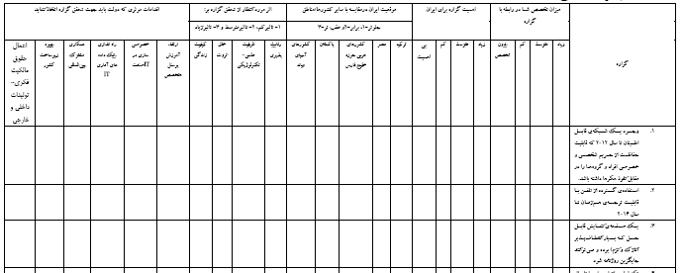
4th Part questions (Tech. Areas)
Notes:
51

Slide 52
Example of 4th Part in Communication Field (PAMFA 1404)
A medical chip that can be embedded in the human body and run semi-permanently powered by bioenergy sources such as body heat or blood flows, providing vital function support such as health condition monitoring and a heart pacemaker (until 2015)
Effective measures that should be taken by gov’t |  |  |  |  |  | Expected result |  |  |  | Iran’s technological capability level relative to (countries/regions)
Improve IPR System | Infrastructure Development | International Technological Collaboration | Establish of statistical IT data bank | Privatization in IT industry | Improve human’s skill & education | Life quality | Wealth-creation | Scientific-technologic capacity | competitiveness | Central Asia | Pakistan | Arabic states of Persian gulf | Egypt | turkey
18 | 34 | 24 | 42 | 32 | 32 | 2.22 | 1.75 | 2.10 | 1.89 | 1.64 | 1.74 | 1.97 | 1.83 | 2.35
Notes:
52

Slide 53
Expected result
A medical chip that can be embedded in the human body and run semi-permanently powered by bioenergy sources such as body heat or blood flows, providing vital function support such as health condition monitoring and a heart pacemaker (until 2015)

Slide 54
Iran’s technological capability level relative to (countries/regions)
A medical chip that can be embedded in the human body and run semi-permanently powered by bioenergy sources such as body heat or blood flows, providing vital function support such as health condition monitoring and a heart pacemaker (until 2015)

Slide 55
Effective measures that should be taken by Gov’t
A medical chip that can be embedded in the human body and run semi-permanently powered by bioenergy sources such as body heat or blood flows, providing vital function support such as health condition monitoring and a heart pacemaker (until 2015)

Slide 56
Totally for each Sector
Iran’s technological capability level relative to (countries/regions)
Exp. Marine Sector
Iran situation in compare with other countries/regions
Turkey | Egypt | Arabic countries in Persian gulf coast | Pakistan | Central Asia countries | area
2.25 | 1.77 | 1.94 | 1.65 | 1.59 | Marine area

Slide 57
Iran’s technological capability level relative to (countries/regions)
All Area
Notes:
57

Slide 58
2-Scenario Planning Method
Selecting suitable approach among different approach
Using of research experiences in industry and defense sector
Main approach
Intuition Based logic
Cross-Impact Analysis
Trend- Impact analysis

Slide 59
Steps of PAMFA Scenario- planning project
Identification of factors that shape the future
Identification of uncertainties
Specifying scenarios
Identification of major axes
Scenario Analysis
Case Studies
Trend Analysis
Brain storming
Cross -compact analysis
Interview with experts
Global studies
Cross- compact analysis
Experts panel
Experts Panel
Delphi questionnaire
survey of White papers and national programs
Robust Planning

Slide 60
Identification of factors that shape the future
Identification of uncertainties
Specifying scenarios
Identification of major axes
Scenario
Analysis
For identifying uncertainties, it is necessary to determine the final Impact and affecting of each factor

Slide 61
Formation of Cross Impact Analysis
The total of columns and rows shows the direct level of Influence and dependence degree in system

Slide 62
Identification of factors that shape the future
Identification of uncertainties
Specifying scenarios
Identification of major axes
Scenario
Analysis
The more influence and dependence of a factor is high, the more it leads the system to be unstable

Slide 63
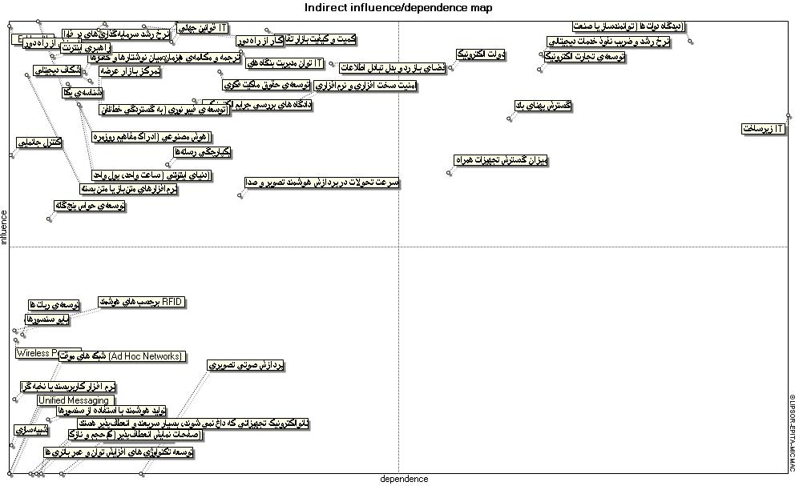
Analyzing each panel member answers with using cross-impact analysis method

Slide 64
Scenario Axes identification
Factor 1- Alternative 1
Factor 2- Alternative 2
Factor 2- Alternative 1
Factor 1- Alternative2

Slide 65
Analyzing of each person opinions with using cross-impact analysis methods

Slide 66
Scenario Axes identification
Factor 1- Alternative 1
Factor 2- Alternative 2
Factor 2- Alternative 1
Factor 1- Alternative2

Slide 67
Identification of factors that shape the future
Identification of uncertainties
Specify of Scenarios
Identification of Scenario axis
Scenario analysis
Convergence of marine and Petroleum industries
Marine’s structures
Fast Afloat
Control and Sonar systems
Military Ships (Navy)
Marine’s Exploitation structures
Transfer pipes
Offshore structures
Insecure
Secure
Military Ships (Navy)
Submarine
Torpedo & Missile Submarine
Marine’s weaponry & Mines
Commercial vessels
Entertainment & Sports
Fishing vessels
Divergence of marine and Petroleum industries

Slide 68
Identification of factors that shape the future
Identification of uncertainties
Specify of Scenarios
Identification of Scenario axis
Scenario analysis
privatization
Expert human resource
Local expert human resource
Welfare facilities
Ethnical differences
Lobbies and miss recognition
Emission of technical and engineering services
Establishment of environmental parks
Tourism and marina
Basic industries in coast
Development of railway between ports and coasts
Industrial sewage
Self-exploitation
Aquatic demands
Hydrocarbon pollution(oil, gas,..)
Existence of financial sources
Foreign investment
National assiduity (tendency)
Population distribution in coast
Geopolitics
Environmental protection
Marine gas and oil sources
None gas and oil sources
Fishing in sea
Imports and exports volume
Cast socials industrialization
Decentralism and federalism
Politic conflict
Logistic industries

Slide 69
Identification of factors that shape the future
Identification of uncertainties
Specify of Scenarios
Identification of Scenario axis
Scenario analysis
Convergence of oil and marine industries
Example:
Environmental protection
Countries interactive relationships for marine environmental collaboration.
More marine activities and essentiality of accurate control of gas and oil leakage.
Control of explanatory activities by consider to environmental harmfully.
Pollution of wave emmision of radar, sonar and safety control equipments .
Pollution of marine weaponry.
Military presence and increase of environmental pollution.
Insecure
Secure
countries interactive relationships for protect of marine environments.
Convention on Biological Diversity (CBD)
Enormous fishing .
more transportation and essentiality of accurate control.
More attention to environments of ports and coasts.
Ignoring of environment aspects
Pollution of marine weaponry like torpedo and mine …
Divergence of oil and marine industries

Slide 70
Thank you

